Slide 2

Module Objectives
Need for Artificial Intelligence (AI) /Machine Learning (ML) /Data Science in Cybersecurity
AI, ML, and Data Science Methodologies
Overview of Data Science/ML Applications in Cybersecurity

Slide 3
Adaptive Cybersecurity Systems

Slide 4
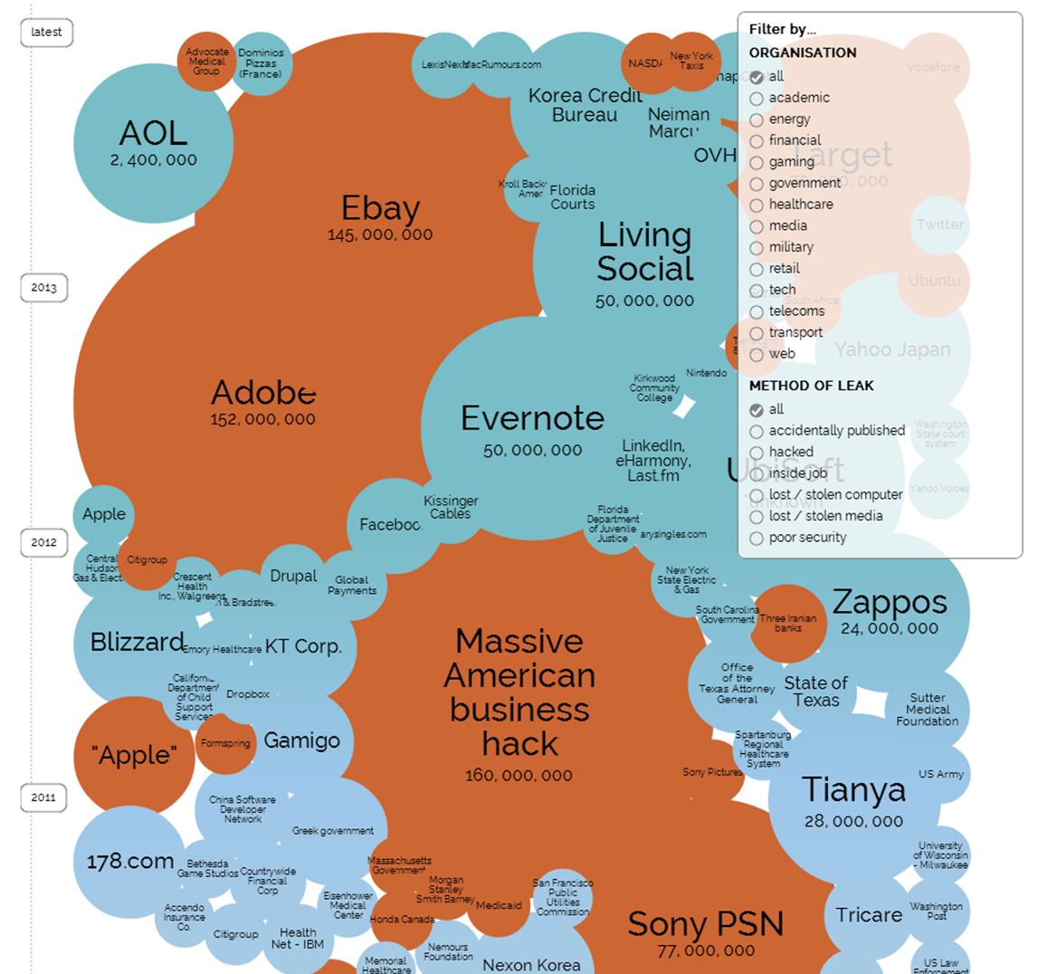
Need for Cybersecurity

Slide 5
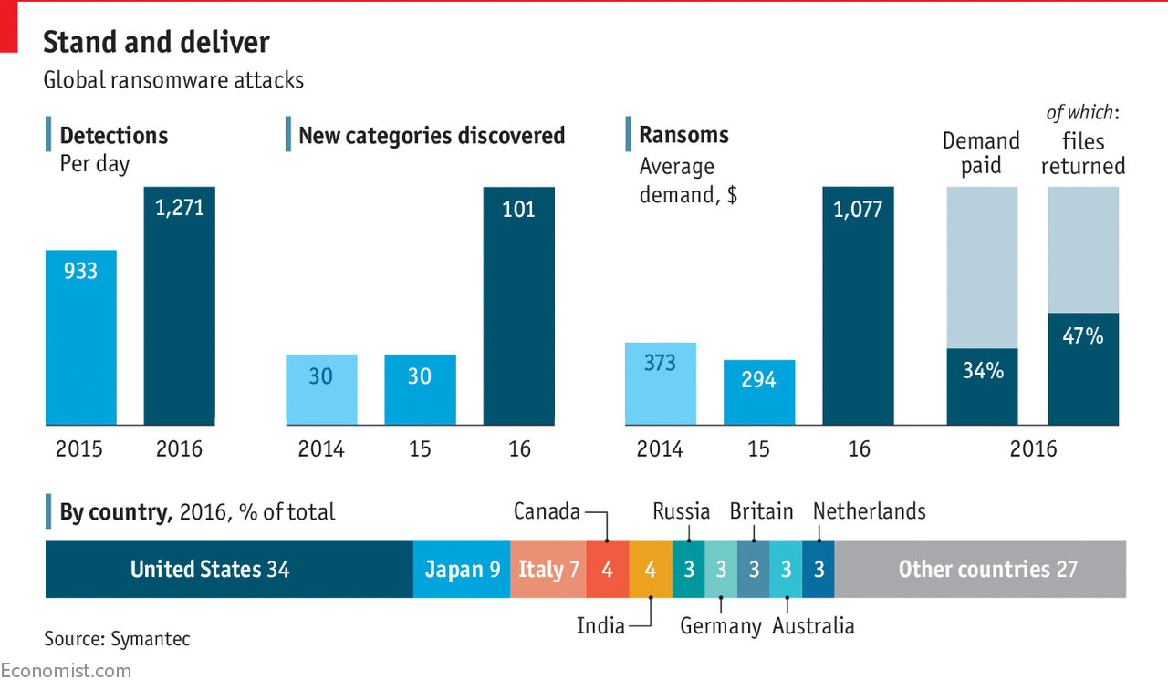
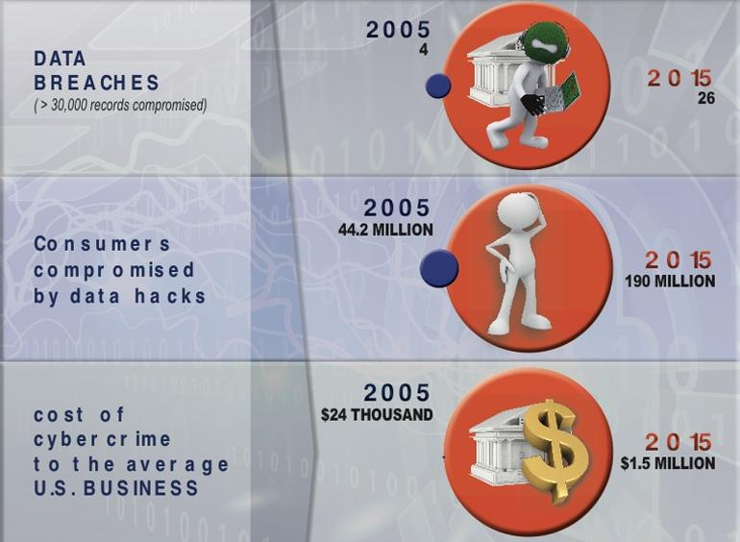
Data Breaches on the Rise

Slide 6

Need for Cybersecurity
“…something I worry will change in a world of physically capable computers. Automation, autonomy, and physical agency will make computer security a matter of life and death, and not just a matter of data.”

Slide 7
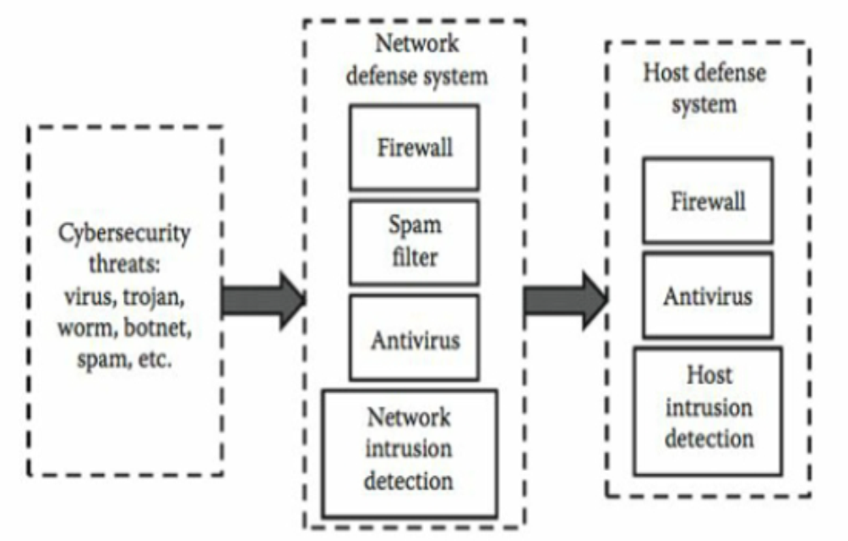
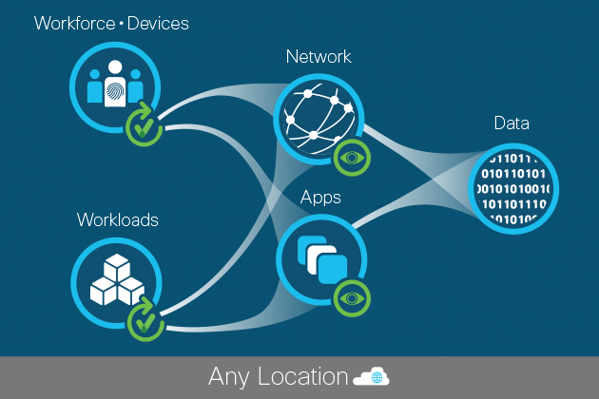
Cybersecurity Systems
Cybersecurity systems
Addresses various security threats
Trojans, worms, spam, botnets
Combat’s security threats at two levels
Network based defenses
Host based defenses
Conventional approaches
Firewalls, Authentication tools
Anti-virus software
Challenges in the form of vulnerabilities however persist due to flaws in the design and implementation of software.
Source: Data Mining & ML in Cybersecurity (2011)
Cybersecurity system
Zero Trust security model
Higher-level adaptive cyber security systems are needed based on AI/ML technologies
What is the Solution ?

Slide 8
Adaptive AI/ML Systems for Cybersecurity
Capture events from audit trails depending on host or network
Ex: Wincap for Windows, Libcap for Linux, Solaris BSM for SUN
Host based events typically originate with log files.
Sequence of commands executed by user,
System calls launched by an application
Network based events originates with network traffic
Sequence of IP or TCP network packets
Features that are insightful for analysis are extracted from cleaned data
Analysis is where AI, ML, & Data Mining techniques are implemented
Defensive strategies are then employed in neutralizing threats

Slide 9
AI, Machine Learning, & Datascience Methodologies

Slide 10
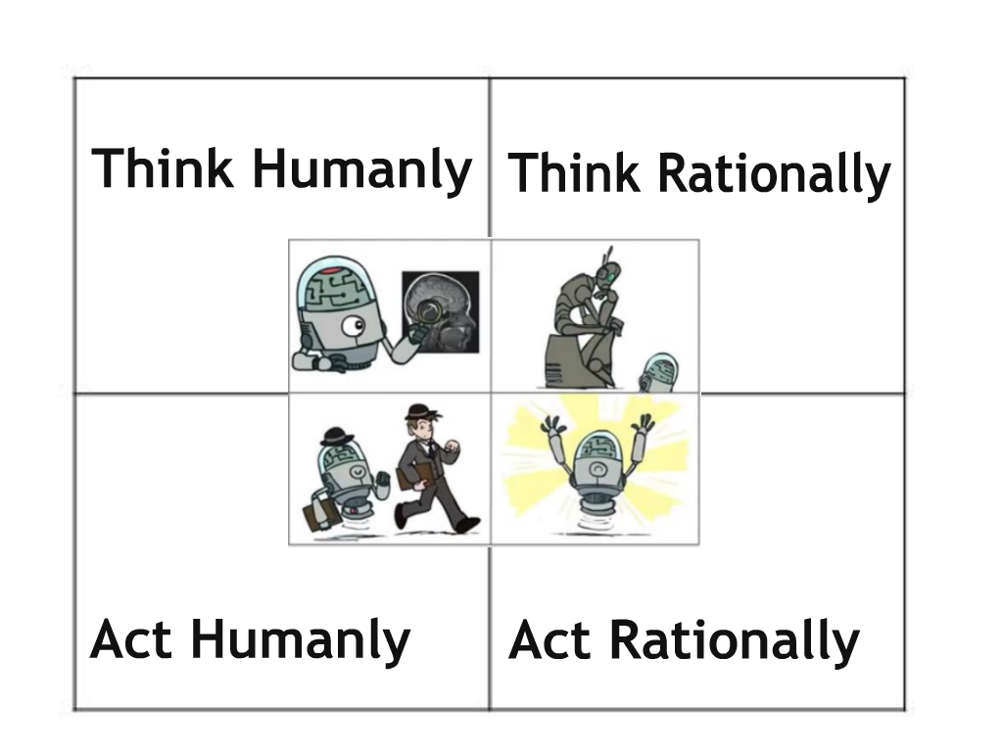
What is Artificial Intelligence?
Artificial Intelligence:
Study of the design & creation of intelligent entities
For the purpose of:
Simulating intelligent behavior in machines/computers
Notes:
Also AI doesn’t have some of human limitations: Short term memory loss, sleep deprivation, information overload, and distractions.
Also its not human vs machine, its human & machine versus problem. Goal of AI is to make humans accomplish more in less time, by taking away some of the repetitive tasks, and let humans do what they do best. Strategize and plan.

Slide 11

AI in Cybersecurity

Slide 12
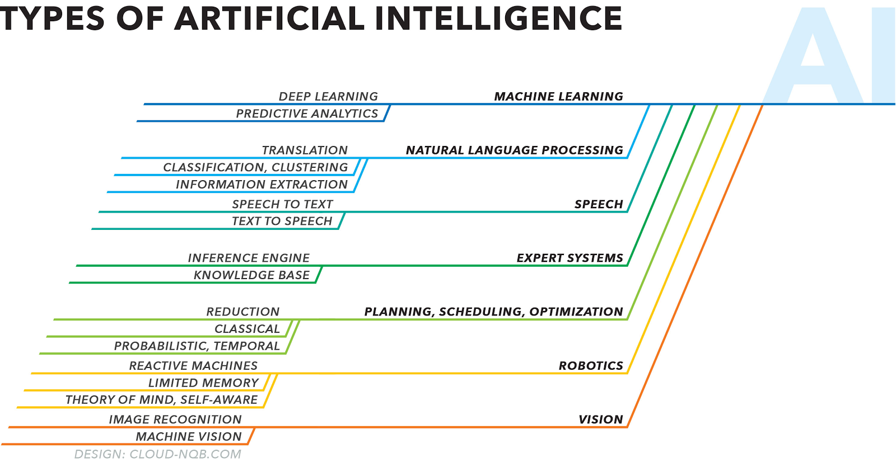
How Broad Is AI?

Slide 13


What is Machine Learning (ML)?
Machine learning is the process of ‘learning’ from past data/experiences in order to predict future
Complex computation process of automatic pattern recognition and intelligent decision making.
Set of mathematical techniques, implemented on computer systems, that enables a process of information mining, pattern discovery, and drawing inferences from data
Data feed into ML algorithms provides the necessary logic without the need to write code

Slide 14
Machine Learning Techniques
Regression
Predictive (Supervised Learning)
Classification
Machine Learning
Time Series
Association Rule
Descriptive (Unsupervised Learning)
Clustering
Dimensionality Reduction
Additionally: semi-supervised learning methods are possible, such as Reinforcement Learning, Generative Adversarial Networks (GANs), etc.

Slide 15

Machine Learning can be applied for diverse tasks in Cybersecurity

Slide 16
Relation between AI, ML, Data Science?
Data science is an interdisciplinary field (AI, ML, Statistics, Programming, Math, HPC, and Data Mining) that employs analytical tools in extracting actionable insights from large volumes and varieties of data to improve the processes and decision making

Slide 17
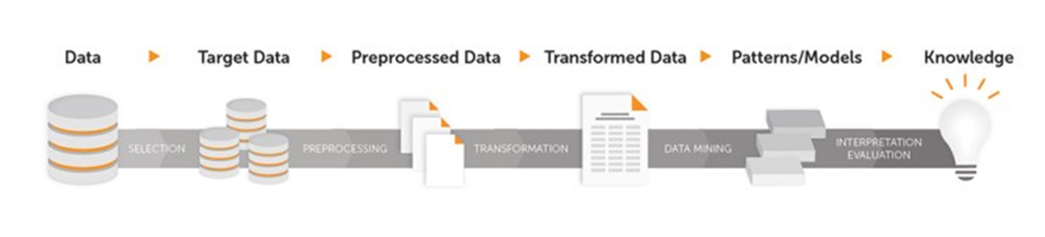
Data Science Procedure
Step 1: | Data Capture & Collection – Data sourcing, integration
Step 2: | Data Visualization/Exploration – Preliminary insight
Step 3: | Data Preparation/Feature extraction – Clean/transform
Step 4: | Data Analysis (Modeling) –Apply & tune ML models
Step 5: | Model Evaluation- Evaluate accuracy of model on test data
Step 6: | Predict/Deploy – Apply actionable intelligence gained from the analysis in thwarting cyber threats.
Example of Feature extraction for cybersecurity
Sequence of System calls
Start time
Duration of network flow
Source IP
Source port
Destination IP
Destination port
Protocol
Number of bytes
Number of packets

Slide 18







AI/ML/Data Science Tools
Data Visualization Tools:
Data Analytics Tools:
Automated ML Tools:
Deep Learning Tools:

Slide 19
Select ML Applications in Cybersecurity

Slide 20
ML Applications in Cybersecurity
ML applications in security can be classified into two categories:
Misuse/Signature/Pattern Recognition
Anomaly Detection
Line demarcating Signature Detection and Anomaly Detection can sometimes be blurry
Misuse/Signature Detection: Captures known threats (used for balanced data set)
Anomaly Detection: Tries to find rare novel attacks.

Slide 21
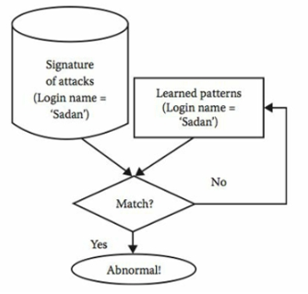
Misuse/Signature Detection
Intrusion detection method that generates alarm when a known cyber threat occurs.
Measures the similarity between input events and signatures of known events.
Known attacks can be easily detected.
Many signature detection applications are based on supervised algorithms. But unsupervised methods such as ARM are also utilized.
Lower False Positive Rates
Cannot detect novel/unknown attacks
Misuse detection using if-then rules
Source: Data Mining & ML in Cybersecurity (2011)

Slide 22
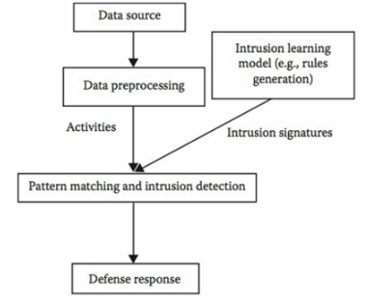
Misuse/Signature Detection
Strength of a misuse/signature detection system depends on sufficient knowledge of known attack patterns.
Traditionally, domain experts were utilized to create such attack pattern databases, leading to inconsistencies and inaccurate detection.
But with machine learning, the process is automated and more robust
Supervised and unsupervised methods can both be applied for Misuse/Signature detection
Typical workflow for a misuse detection system
Source: Data Mining & ML in Cybersecurity (2011)

Slide 23
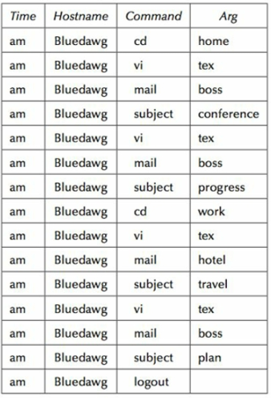
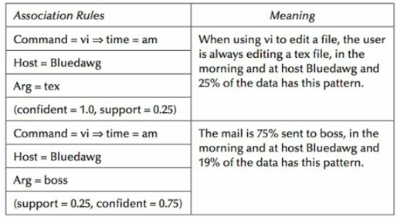
Misuse/Signature Detection Example 1
Association Rules Mining - Host-based telnet session data
Shell Command Data
Association Rules generated for the shell command data
25 %
Source: Data Mining & ML in Cybersecurity (2011)

Slide 24
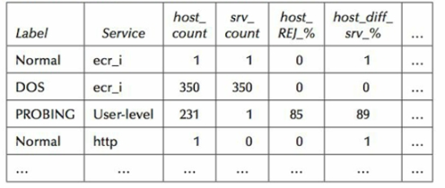
Misuse/Signature Detection Example 2
Association Rules Mining – Network Traffic Data
Network Traffic Data
Association Rules generated from the network traffic data
Source: Data Mining & ML in Cybersecurity (2011)

Slide 25


Misuse/Signature Detection Example 3
Supervised Learning - Classification
Spam Identification in Emails
Emails are broken down into word counts
 | URL | help | deal | prize | Spam/ no spam
1 | 1 | 0 | 1 | 1 | 0
2 | 0 | 1 | 0 | 0 | 1
3 | 1 | 1 | 0 | 1 | 0
4 | 1 | 0 | 1 | 1 | 0
5 | 1 | 0 | 0 | 1 | 1
X: Independent variables (word count in email)
Y : Target variable - Spam (1) or No spam (0)
Goal: Y ~ f(X) (for numeric algorithms)
Spam
Or
No spam
URL | help | deal | prize
1 | 0 | 1 | 1
f(X)

Slide 26
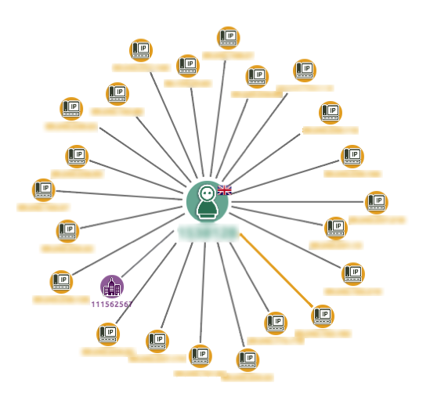
Anomaly Detection
Anomaly detection refers to identifying unexpected or unknown threats.
Normal data is first analyzed. Any deviation from normal patterns is treated as an anomaly.
Typically used for imbalanced data sets
Very effective in discovering novel attacks.
Diverse Applications
Identifying cyber threats, fraud detection
Anomalies in electric power grid

Slide 27
Anomaly Detection Techniques
Forecasting – Used for time series data
Statistical Metrics
Deviations (or Mean absolute deviation) from average
Visualization Charts
Goodness of Fit Methods
For datasets which follow a known distribution (ex: gaussian)
Unsupervised Learning
ARM
One-class classifiers
Clustering

Slide 28
Forecasting
It uses past data to predict current and future data.
It is a form of supervised learning since it trains a regression model of data values versus time.
Suitable for single-dimension time series data (Ex: CPU Utilization over time).
Predictions made by a forecasting model will correspond to the expected value that the time series will have in the next time step.
CPU Utilization over time
Source:Machine Learning and Security (2018)

Slide 29
ARIMA
ARIMA (Autoregressive integrated moving average) is a powerful technique to perform forecasting on time-series
Belongs to a class of statistical models that have outputs linearly dependent on their own prior values
Exponential smooth can be treated as a special case of ARIMA
Past or previous time data is regressed to predict current (or future time) data pattern
When the observed values fall in the low-confidence bands of prediction, the model raises an anomaly alert

Slide 30
Anomaly Detection Example 1: Forecasting
Observed data
Observed data
CPU Utilization Rate
No Anomaly
Anomaly
Time
Time
When observed values
differ from prediction,
Anomaly is raised
ARIMA prediction
ARIMA prediction
CPU Utilization Rate
Time
Time

Slide 31
Goodness-of-fit Methods
Suitable when data follows an expected distribution
Ex: API calls to an application server per day (Gaussian Distribution)
Number of hits to a website in the hours after promotion (Exponential Decay)
The model works by first fitting the regular (or normal) data
Any deviations from the expected distribution is considered an anomaly

Slide 32
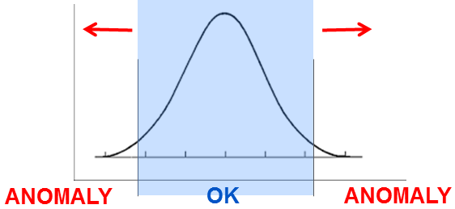
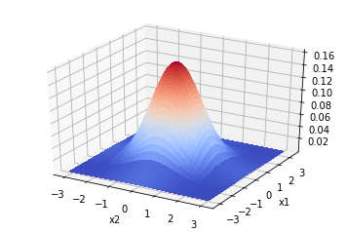
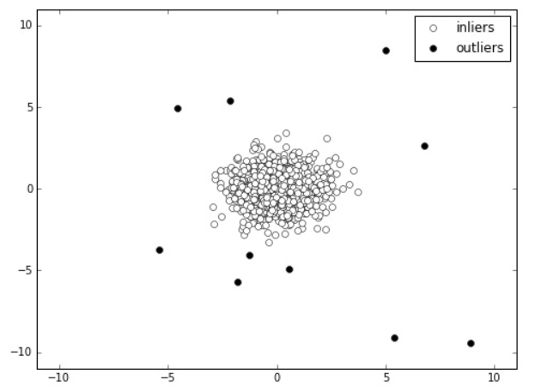
Anomaly Detection Example 2
Goodness of fit: Deviation from Gaussian Distribution
x – Let’s say Peak CPU Utilization
Fit only the normal data using
Gaussian (or normal) distribution
Any new data point which deviates from the gaussian distribution is treated as an anomaly.
P(x)
CPU
Another hypothetical Example with scaled data:
x1 = Peak CPU utilization
x2 = Start time
x2
x1
Notes:
Suitable when dataset follows an expected distribution
Ex: API calls to an application server per day (Gaussian Distribution)
Number of hits to a website in the hours after promotion (Exponential Decay)
The model works by first fitting the regular dataset. Any deviations from the expected distribution is considered an anomaly.

Slide 33
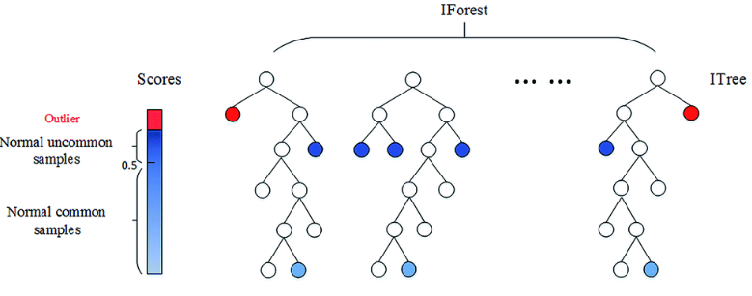
Anomaly Detection Example 3
Unsupervised Learning - Isolation Forests
One of the newer breed of algorithms, but highly useful for anomaly detection
Suitable for non-gaussian and high dimensional datasets
Algorithm trains a model on the dataset, by randomly splitting on a feature for each data point and in the process creating trees.
The assumption is that outliers should be easier to isolate with fewer splits, compared to inliers which are expected to have more feature value similarities

Slide 34
Anomaly Detection Example 3
Isolation Forest for Credit Card Fraud Detection
Example: X1 = Transaction Amount, X2 = Number of transactions in the last 24 hrs
Anomaly (Fewer Splits)
Normal (More Splits)
(# of transactions)
(# of transactions)
(Transaction Amount)
(Transaction Amount)

Slide 35
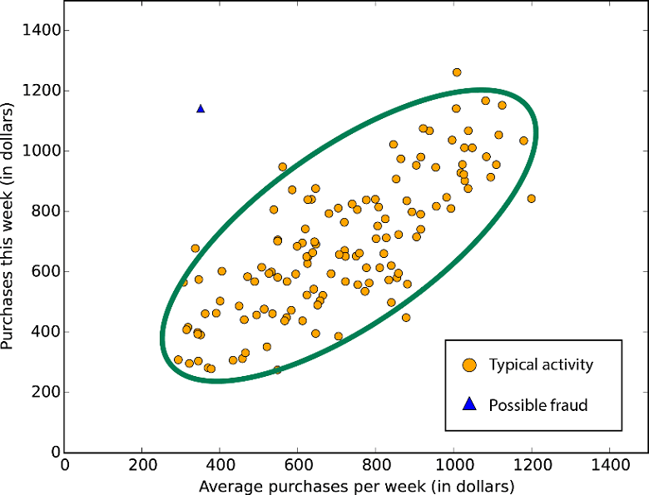
Anomaly Detection – Example 4
Unsupervised Learning with Clustering – Fraud Detection
Number of cluster sizes are assumed (typically, k=2)
Assumption is that normal data points clearly out-number the anomalous data
Clusters are then identified as ‘normal’ and ‘abnormal’
Possible to misclassify some small-sized normal data groups as FP’s

Slide 36
Anomaly Detection vs Supervised Learning
Anomaly Detection | Supervised Learning
Applied when abnormal data (or threats) are scarce and rare. Imbalanced data set. | Applied when there is significant abnormal (fraudulent, threat) data, from which the model can learn.
Identifies Novel Attacks. Method of intrusion cannot be predicted in advance. | Identifies known attacks.
Many different types of anomalies. Hard for the model to learn from available anomalous data. | Future instances of threats are expected to be similar to known threats in the training data set
Examples: Network outlier detection, malicious URL detection | Examples. Spam, malware, and botnet detection

Slide 37
Challenges in Anomaly Detection
High Stakes - Misclassification of even one anomaly can cause a devastating breach. FN’s are more crippling compared to FP’s.
Difficult to interpret – It can be sometimes difficult to explain why an event was flagged as anomaly leading to longer incident investigation cycles.
Requires continues training of models - System may become less effective as time goes by
Evaluation schemes - Building sound evaluation schemes for anomaly detection systems can be more difficult compared to building the system itself.

Slide 38
Hybrid Detection
Misuse/Signature detection methods have the advantage of correctly classifying known cyber threats (Low FP). But may fail in detecting unknown, novel attacks.
Anomaly detection on the other hand can detect novel attacks, but may result in higher FP’s.
Hybrid detection combines the flexibility and intelligence of anomaly detection and the accuracy of misuse detection systems
Anomaly Detection System
Normals
Attacks
Alerts
Incoming Data
Data Preprocessing
Attacks
Misuse Detection System
Normals

Slide 39
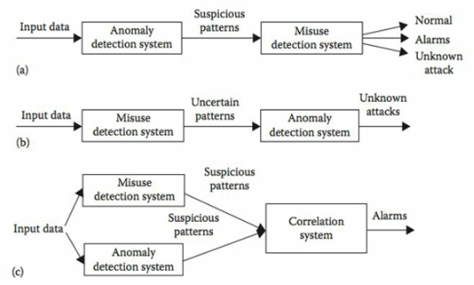
Hybrid Detection Methodologies
Simple assembly of misuse and anomaly detection methods may not be enough.
The combination of these methodologies could be an application-specific problem.
Typical methods available for integration can be classified as shown in the figure by (Zhang et al. 2008)
Source: Data Mining & ML in Cybersecurity (2011)

Slide 40
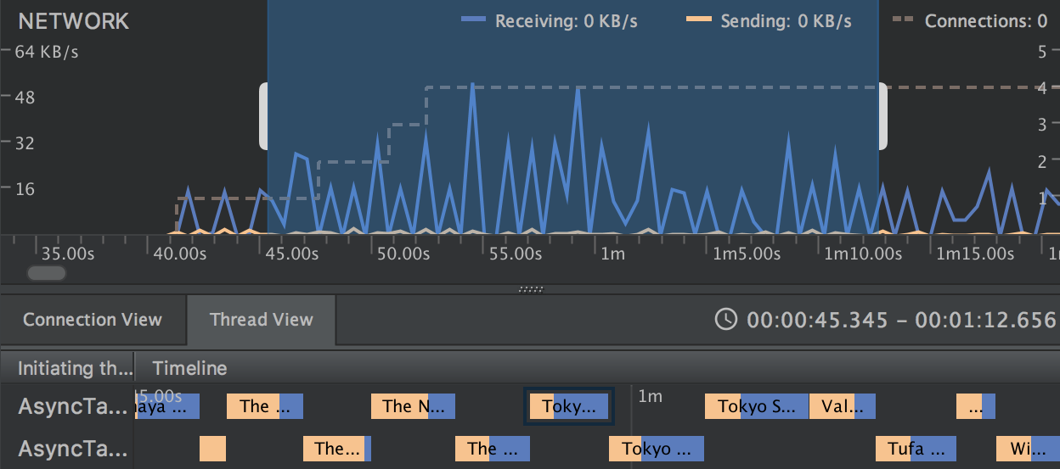
Network Profiling
Network - Prominent pathway for attackers to gain entry into a cyber infrastructure
Profiling - Protecting computer networks by grouping network traffic into similar clusters
Access control systems (Firewalls) have until now been the typical network defense systems.
But as the sophistication of attacks have increased, higher level AI/ML algorithms are being utilized.

Slide 41
Machine Learning in Network Profiling
Incoming Network Traffic Data
Both Supervised and unsupervised ML algorithms can be deployed for classifying or clustering the incoming traffic
Visualizations can also be powerful in profiling network traffic.
Feature Engineering is one of the challenge, since live network data may not be optimal to use right away in the ML process.
Feature Generation
Data Cleaning/Preprocessing
Supervised ML
Unsupervised ML
Evaluation
Prediction/Model Deployment

Slide 42
Other Applications
Machine Learning for Scan Detection
Scans are not real attacks, but precursors to real attacks. Scans can find vulnerabilities in cyberinfrastructures that they can use to infiltrate
Malware Analysis
Study of functionality, purpose, origin, and potential impact of malicious software.
Protecting the consumer web
Machine Learning can also be applied for distinguishing malicious activity from legitimate activities for several web and internet-facing API’s.

Slide 43
Thank You ☺
Any questions?

